Slide 1
MATHEMATICAL FOUNDATION FOR COMPUTER SCIENCE
Prepared by: Er. Ankit Kharel
Nepal college of information technology

Slide 2
Finite state automata
• Sequential Circuits and Finite state Machine
• Finite State Automata
• Non-deterministic Finite State Automata
• Language and Grammars
• Language and Automata
• Regular Expression

Slide 3
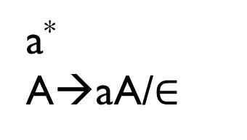

GENERATING GRAMMAR FOR THE LANGUAGE:
1. First write the Regular Expression for the language.
Some Basic Rules:
a*
A→aA/$∈$
(a+b)*
A→aA/bA/$∈$
(a+b)⁺
A→aA/bA/a/b

Slide 4


Q. Write the Grammar that generates string having Following Properties:
String of exactly length two
R.E. = (a+b)(a+b)
S→AA
A→a/b
String of at most length 2
R.E. = (a+b+$∈$)(a+b+$∈$)
S→AA
A→a/b/$∈$
c) Starts with a
R.E. = a (a+b)*
S→aA
A→aA/bA/$∈$
c) Ends with ba
R.E. = (a+b)*ba
S→Aba
A→aA/bA/$∈$
d) Stats with a and ends with b
R.E. = a(a+b)*b
S→aAb
A→aA/bA/ $∈$
e) Starts and ends with same symbol
R.E. = a(a+b)*a + b(a+b)*b
S→aAa/bAb/a/b
A→aA/bA/$∈$
f) Starts and ends with different symbol
R.E. = a(a+b)*b + b(a+b)*a
S→aAb/bAa
A→aA/bA/$∈$
c) Ends with ba
R.E. = (a+b)*ba
S→Aba
A→aA/bA/$∈$

Slide 5
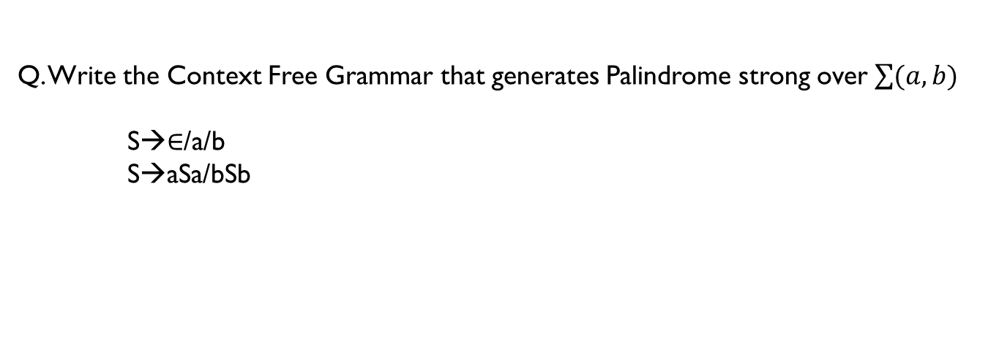
Q. Write the Context Free Grammar that generates Palindrome strong over $\sum{(a,b)}$
S→$∈$/a/b
S→aSa/bSb

Slide 6
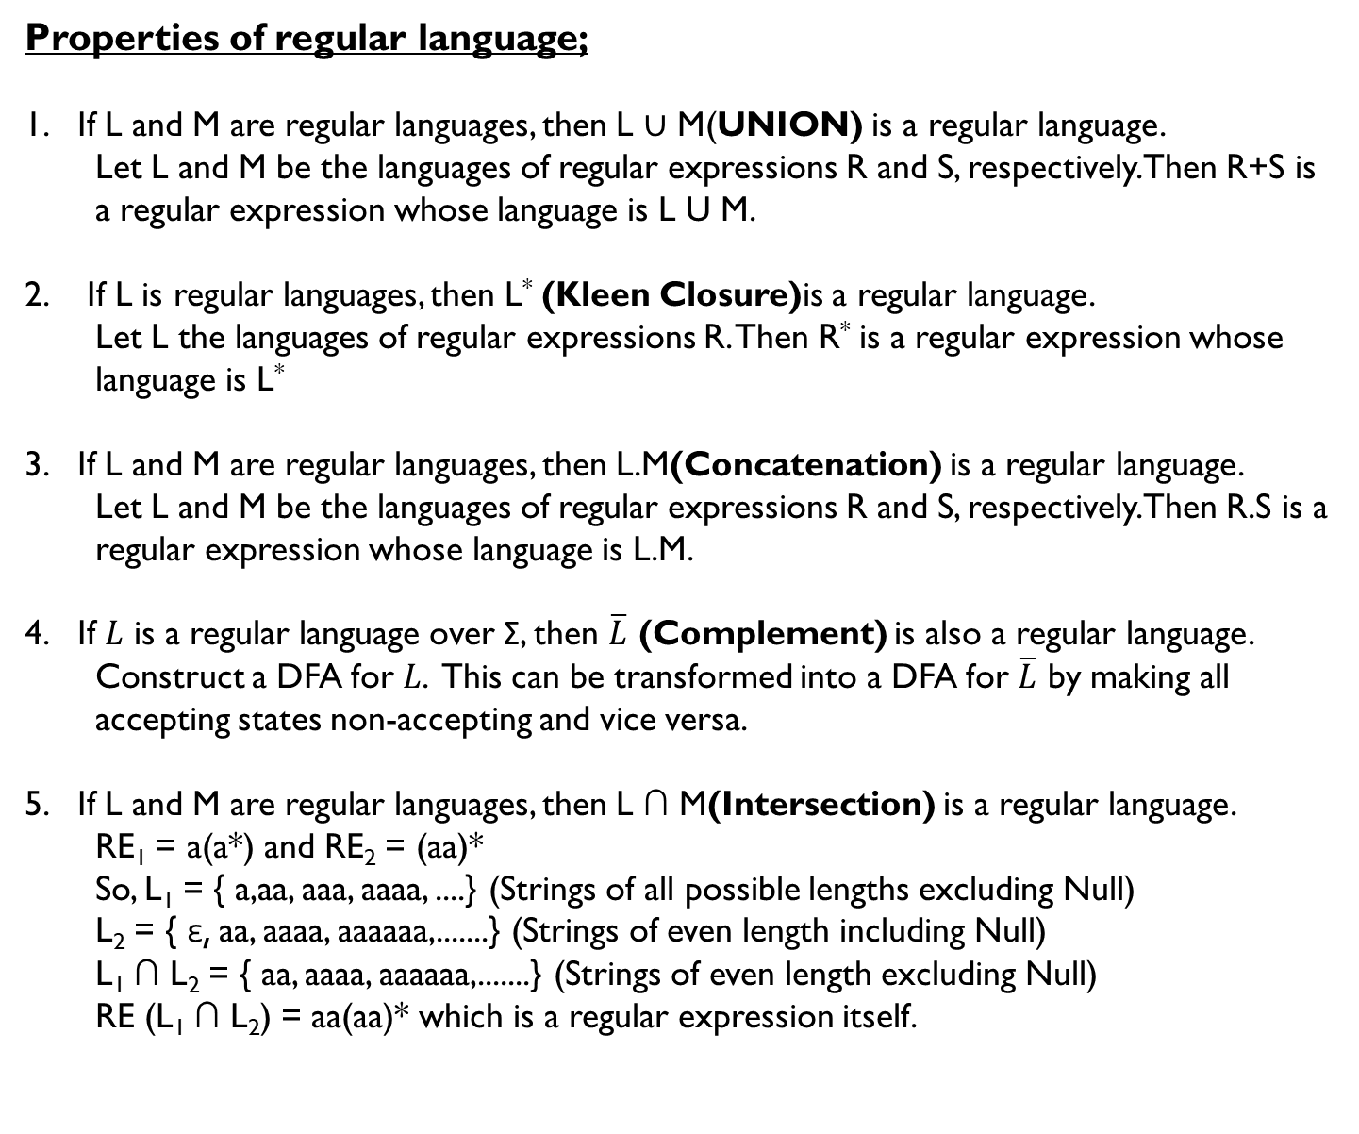
Properties of regular language;
If L and M are regular languages, then L ∪ M(UNION) is a regular language.
Let L and M be the languages of regular expressions R and S, respectively. Then R+S is a regular expression whose language is L U M.
If L is regular languages, then L* (Kleen Closure)is a regular language.
Let L the languages of regular expressions R. Then R* is a regular expression whose language is L*
If L and M are regular languages, then L.M(Concatenation) is a regular language.
Let L and M be the languages of regular expressions R and S, respectively. Then R.S is a regular expression whose language is L.M.
If 𝐿 is a regular language over Σ, then $\overline{L}$ (Complement) is also a regular language.
Construct a DFA for 𝐿. This can be transformed into a DFA for $\overline{L}$ by making all accepting states non-accepting and vice versa.
If L and M are regular languages, then L ∩ M(Intersection) is a regular language.
RE₁ = a(a*) and RE₂ = (aa)*
So, L₁ = { a,aa, aaa, aaaa, ....} (Strings of all possible lengths excluding Null)
L₂ = { ε, aa, aaaa, aaaaaa,.......} (Strings of even length including Null)
L₁ ∩ L₂ = { aa, aaaa, aaaaaa,.......} (Strings of even length excluding Null)
RE (L₁ ∩ L₂) = aa(aa)* which is a regular expression itself.

Slide 7
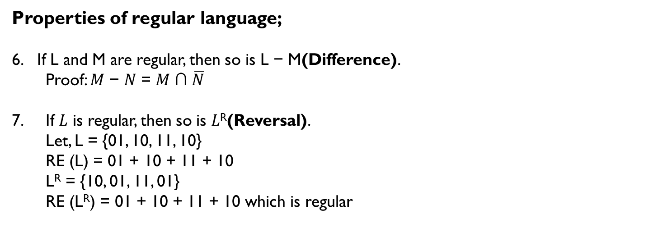
Properties of regular language;
If L and M are regular, then so is L − M(Difference).
Proof: 𝑀 − 𝑁 = 𝑀 ∩ $\overline{N}$
7. If 𝐿 is regular, then so is 𝐿^{R}(Reversal).
Let, L = {01, 10, 11, 10}
RE (L) = 01 + 10 + 11 + 10
L^{R} = {10, 01, 11, 01}
RE (L^{R}) = 01 + 10 + 11 + 10 which is regular

